Slide 1
Unlocking Insights: Data Analytics with Excel – Sukanya

Slide 2
DataSet_1
Changed the format to table
Removed columns like year, month(because this info I can get from dteday)
Changed: instant/season/hr/ weekday/weathersit/temp as number, dteday as short date, holiday as text
Sorted data, tried to do conditional formatting based on duplicate date, removed duplicate rows (no highlights & no duplicate data)

Slide 3
Dataset_2
Removed column Unnamed: 0
Changed the format to table
Changed: instant/atemp/hum/windspeed/casual/registered/cnt as number
Sorted data, tried to do conditional formatting based on duplicate date, removed duplicate rows (no highlights & no duplicate data)

Slide 4
Dataset_3
Changed the format to table
Removed columns like year, month(because this info I can get from dteday)
Changed: instant/season/hr/weekday/weathersit/temp/atemp/hum/windspeed/casual/registered/cnt as number, dteday as short date, holiday as text
Sorted data, tried to do conditional formatting based on duplicate date, removed duplicate rows (no highlights & no duplicate data)

Slide 5
Merge Dataset_1 & Dataset_2
Imported Dataset_1 & Dataset_2 -> Merged based on instant
Changed: instant/season/hr/ weekday/weathersit/temp/atemp/hum/windspeed/casual/registered/cnt as number, dteday as short date, holiday as text
Sorted data, tried to do conditional formatting based on duplicate date, removed duplicate rows (no highlights & no duplicate data)

Slide 6
Merge Dataset_12 & Dataset_3
Imported Dataset_12 & Dataset_3 -> Appended tables Dataset_12 and Dataset_3
Changed table format
Changed: instant/season/hr/ weekday/weathersit/temp/atemp/hum/windspeed/casual/registered/cnt as number, dteday as short date, holiday as text
Added column ‘season’ applying formula {VLOOKUP([@season2],Season!$A$1:$B$4,2,FALSE)}
Added column ‘weekday’ applying formula {IF(TRIM([@Holiday])="FALSE","Weekday","Weekend")}-> because numbers cannot give proper info
Added column ‘week’ applying formula {LOWER(TEXT([@dteday],"dddd"))}
Added column ‘weather’ applying formula {INDEX(Weathercond!$B$2:$B$6,MATCH([@weathersit],Weathercond!$A$2:$A$6,0))} -> because numbers cannot give proper info
Hidden column season, holiday, weekday, weathersit
Changed: season, weekday, week, weathercond as text
Sorted data, tried to do conditional formatting based on duplicate date, removed duplicate rows (no highlights & no duplicate data)

Slide 7
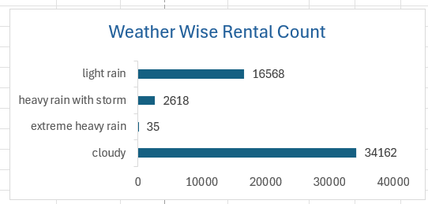
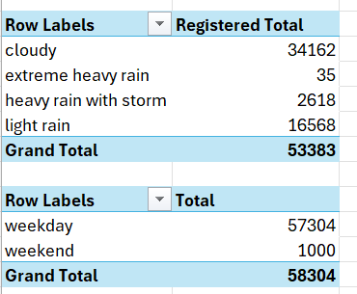
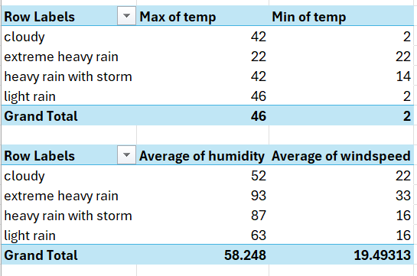
Pivot Table & Charts
Weather cond & Registered sum shows bikes are rented more during cloudy or light rain
Weekday & total count shows highest booking on weekdays
Week & total count shows all days have almost same count
Dteday, casual, registered, total shows in Feb it had max count
Hours & week shows from 0-8 hr it has max bookings and then at 23 hr excluding Friday & Saturday
Weather cond & temp shows weather wise min and max temp
Weather cond & temp shows relation between humidity & windspeed

Slide 8
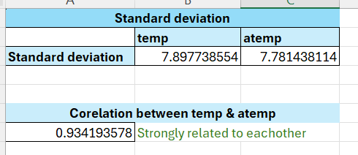
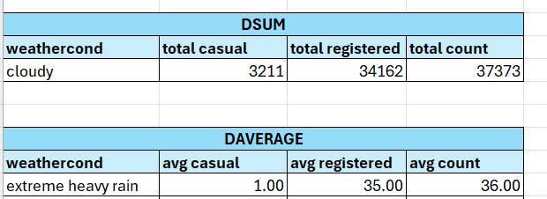
Advanced Data Analysis
Standard deviation between temp and atemp: shows how these values are deviating from mean on a graph.
Corelation between temp & atemp: the values show how they related with each other, in this case they are strong related.
Sumif, Countif: sums or counts based on criteria defined.
DSUM, Daverage: sums and calculates average based on criteria selected.

Slide 9
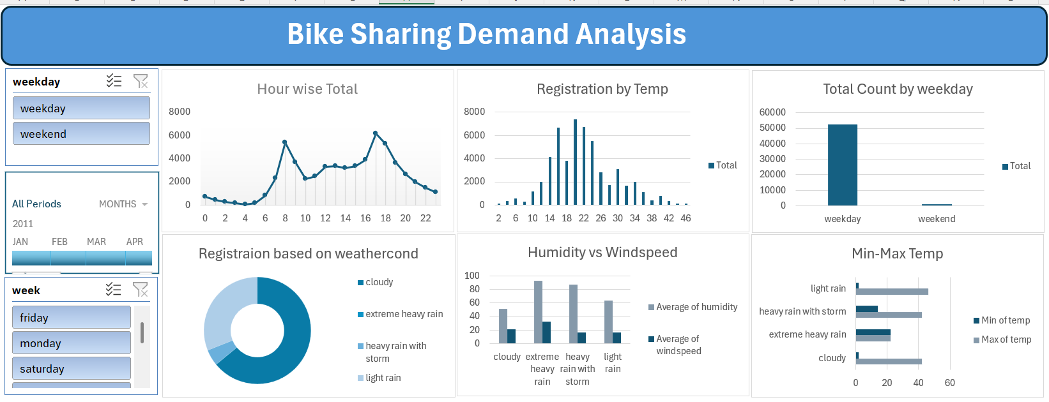
Dashboard

Slide 10
Slicers & Timelines
Weekday & dteday & week: affecting all the visuals.
Key Visuals
Hour wise Total: At 8am & 5pm(17) total is maximum booking count & also from 6am the line is showing up and down till 11pm i.e showing bike sharing count in total.
Registration by Temp: Registration is increasing when temp is raising till 20 degree and after that its decreasing till 40 and post that its very less registration so temp is affecting the registration..
Registration based on weathercond: showing different weathercond and its affect on registration.
Humidity vs Windspeed: column chart showing how humidity affects the windspeed.

Slide 11
Macros
Created macro for formatting as table, cleaning the data by adding few columns based on number i.e instead of some number adding meaning full data, changing data types.
Macro name: CleanRefinedataset

Slide 12
Thank You ☺

